Slide 1
Name: Viren Chhabria ID: 18301780
Data Visualization – CS7DS4
Assignment 4.1
Code: https://github.com/chhabriv/Data-Visualization/tree/master/barcelona-dataset-anaysis

Slide 2
Part A Barcelona Pedestrian Accidents - 2017
Data Source:
Pedestrian Crossings: https://opendata-ajuntament.barcelona.cat/data/en/dataset/infraestructures-inventari-pas-vianants
Pedestrian Accidents: https://opendata-ajuntament.barcelona.cat/data/en/dataset/accidents-gu-bcn

Slide 3
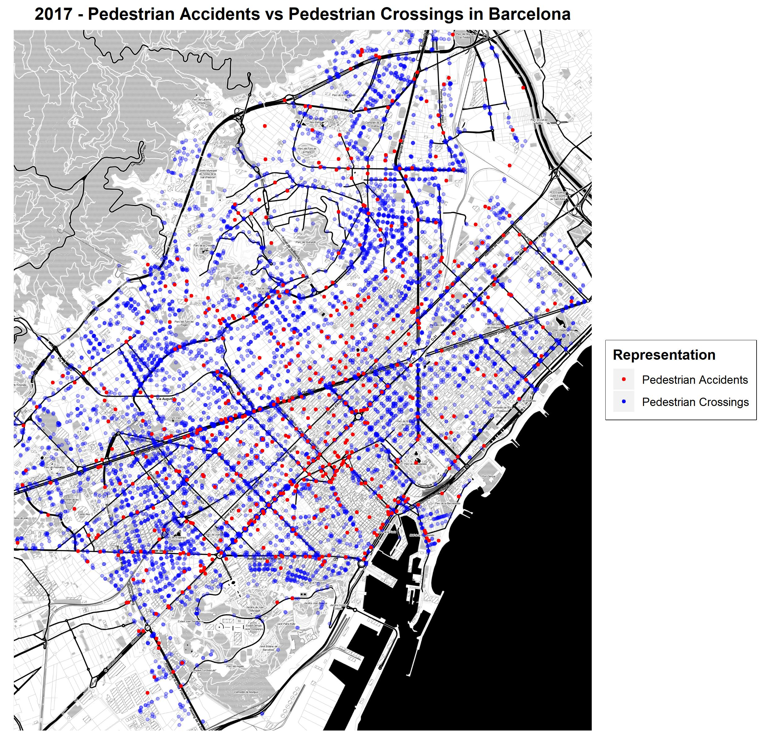
In this Spatial Visualization, the pedestrian crossings and pedestrian accidents are depicted that occurred in Barcelona in 2017.
It is evident from the map, that there are areas in Barcelona where pedestrian accidents occurred, due to lack of pedestrian crossing in those areas. However, in certain areas, pedestrian accidents took place, despite the presence of crossings.

Slide 4
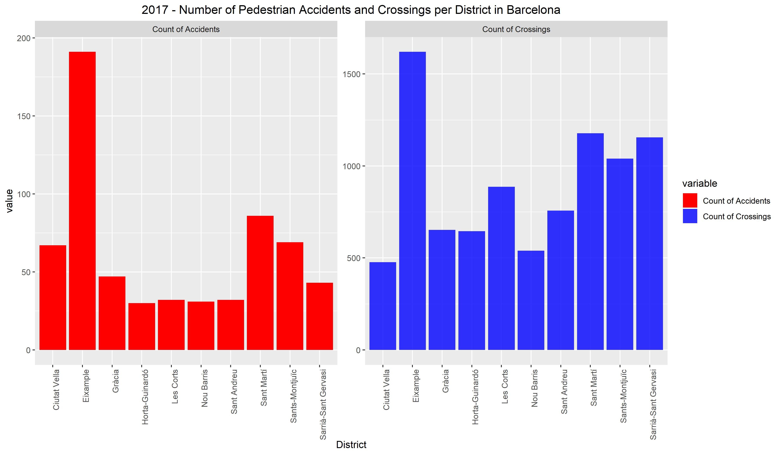
Pedestrian crossings and accidents are shown here in actual numbers. They have been grouped by district.
The colour scheme remains the same as the Spatial Visualization for better visual correlation between the components.

Slide 5
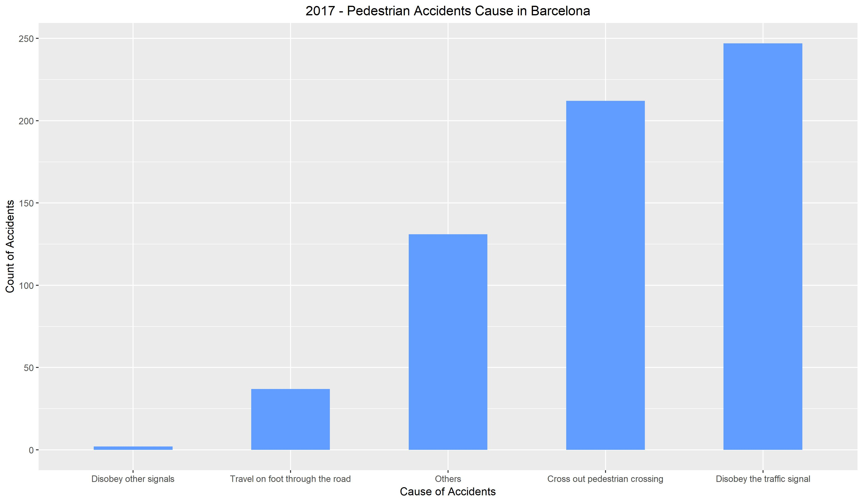
In this Bar Plot, a distribution of number of pedestrian accidents can be seen with respect to the cause of pedestrian accidents - as reported by the local authorities of Barcelona.
In the earlier Spatial Map, it was observed that some of the pedestrian accidents occurred at locations where pedestrian crossings were available. This can be attributed to the high number of pedestrians crossing outside of the pedestrian crossing as see in this bar plot.

Slide 6
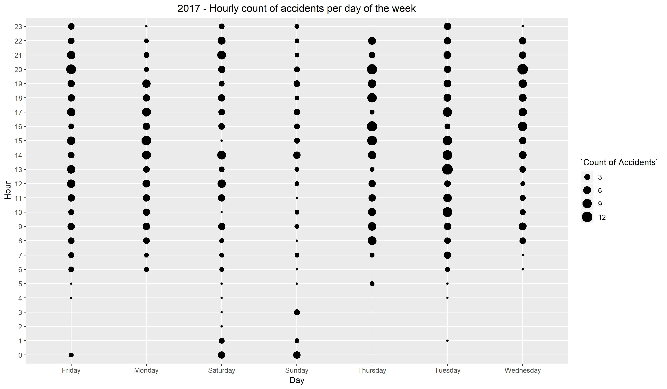
This Scatter-Bubble plot has been used to show relationship between 3 dimensions of the data – Day of the Week, Hour of the Day and the respective number of accidents.
This plot shows some clear trends about when the pedestrian accidents occur. More pedestrian accidents occurred during peak hours and lesser during weekends and wee hours of a day.

Slide 7
Part B Barcelona Territorial Income and Unemployment - 2017
Data Source:
Territorial Income: https://opendata-ajuntament.barcelona.cat/data/en/dataset/est-renda-familiar
Unemployment Data: https://opendata-ajuntament.barcelona.cat/data/en/dataset/est-atur-sexe

Slide 8
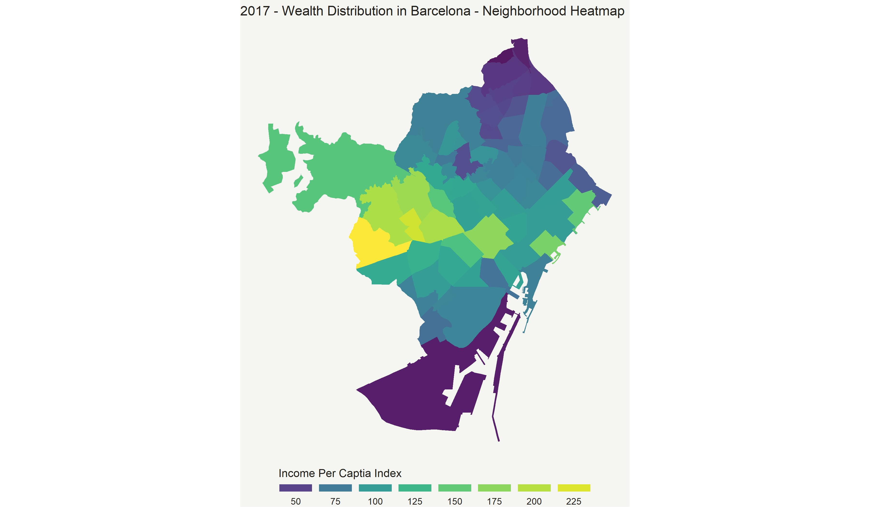
The Choropleth Map of Barcelona shows the wealth distribution across the different neighbourhoods of Barcelona.
The wealth distribution shown is in terms of income per captia index with average = 100.

Slide 9
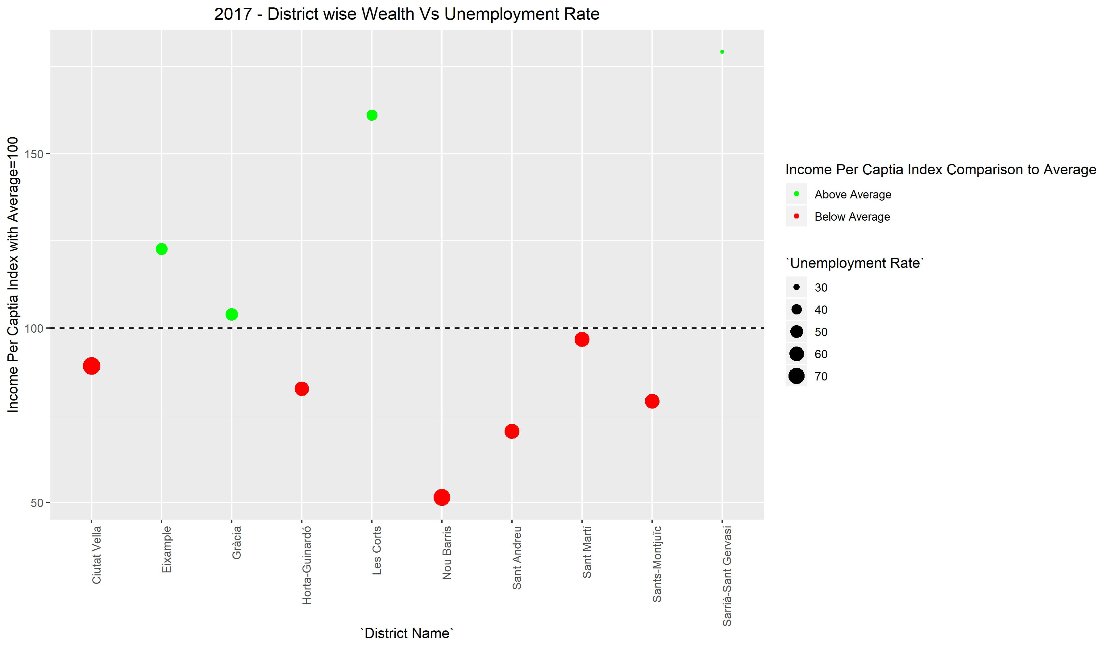
Having seen the territorial income distribution in Barcelona, a correlation between the average income per captia index of a district and the unemployment rate of the respective district can be derived.
It is evident from this chart that the districts that have a higher unemployment rate, have income per captia index below the average.

Slide 10
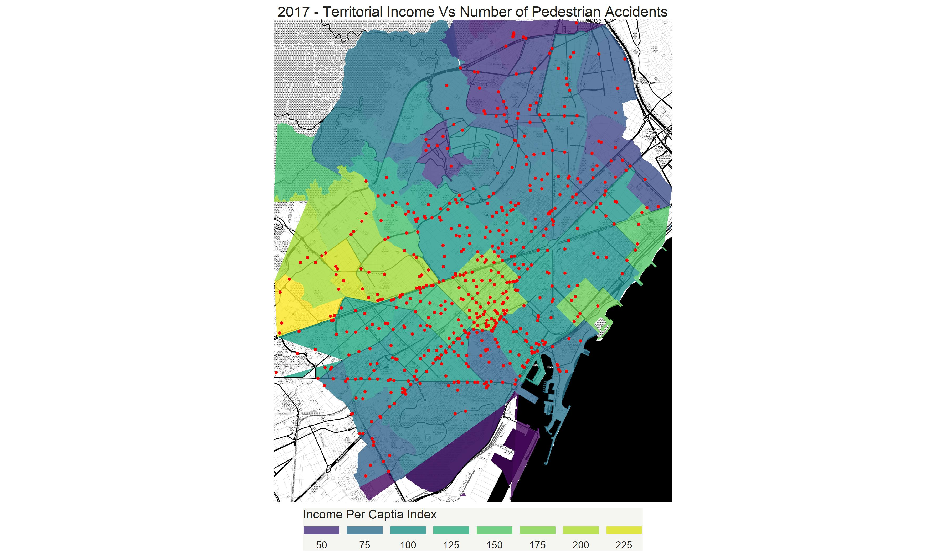
The pedestrian accidents locations shown in Part A were cast as RED dots upon the Choropleth Map depicting the Territorial Income in Barcelona.
An interesting pattern here, shows a higher density of pedestrian accidents in well off areas. This could be due to 2 reasons:
Better Accessibility, hence higher volume of vehicular movement leading to pedestrian accidents
Faster cars in wealthier areas potentially causing a higher number of pedestrian accidents

Slide 11
Thank you

